Slide 1
Trust as a proxy for certainty J. Peter Burgess
Peace Research Institute Oslo

Slide 2
Trust as a proxy for certainty
I. Introduction and definitions
What is trust?
Societal properties of trust
What is security?
Societal properties of security
II. Argument
A necessary accessory
Trust makes insecurity acceptable
Trust engages risk
Trust, security and social cohesion
III. Illustrations

Slide 3
Trust as a proxy for certainty
I. Introduction and definitions
What is trust?
Societal properties of trust
What is security?
Societal properties of security

Slide 4
Trust as a proxy for certainty
II. Argument
A necessary accessory
Trust makes insecurity acceptable
Trust engages risk
Trust expresses the social cohesion in security

Slide 5
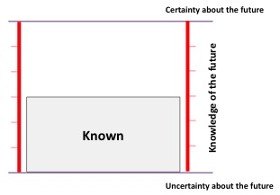
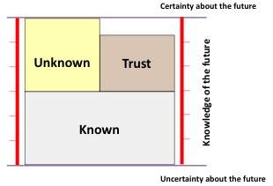
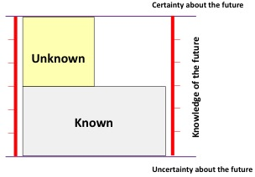
Trust as a proxy for certainty
III. Illustrations: Trust model

Slide 6
Trust as a proxy for certainty
III. Illustrations: Moon landing

Slide 7
Trust as a proxy for certainty
III. Illustrations: Tuna sandwich your mother made

Slide 8
Trust as a proxy for certainty
III. Illustrations: Injection from the family doctor

Slide 9
Trust as a proxy for certainty
III. Illustrations: First day of school

Slide 10
Trust as a proxy for certainty
III. Illustrations: Norwegian crossing the street in Oslo

Slide 11
Trust as a proxy for certainty
III. Illustrations: Norwegian crossing the street in Kolkata

Slide 12
Trust as a proxy for certainty
III. Illustrations: Indian crossing the street in Kolkata

Slide 13
Trust as a proxy for certainty
III. Illustrations: Indian crossing the street in Kolkata

Slide 14
Trust as a proxy for certainty
III. Illustrations: Experience of terror threat in Oslo

Slide 15
Trust as a proxy for certainty
III. Illustrations: Experience of terror threat in Tel Aviv

Slide 16
J. Peter Burgess
peter@prio.no

